Slide 1
Racism in Healthcare: When the Patient Refuses Care
Gaurdia Banister, PhD, RN, NEA-BC, FAAN
Executive Director, The Institute for Patient Care
Director, The Yvonne L. Munn Center for Nursing Research Connell-Jones Endowed Chair in Nursing and Patient Care Research

Slide 2
Objectives
Review of Ethical Considerations
Review of Historical Factors that have Influenced Racism in Healthcare
Experiences of racism in the practice environment
Identify organizational strategies that help identify and reduce behaviors
Policy Development
Patient Accountability
Conclusion

Slide 3
A True Story
Notes:
A patient asked the PCA, “What are you?” and she replied, “I’m a PCA.” And he said, “No, what kind of animal are you?”
We had a patient make derogatory remarks to both the RN and PCA, and the PCA was very upset. The RN walked into the room and introduced himself, and patient said, “when you are in Rome, do as Romans do and so in America, speak American English”; the RN is a black male immigrant from Ethiopia & has an accent. The PCA (female immigrant from Ecuador with an accent) later walked in and asked the patient if he needed any assistance with getting to the shower & he threw her out of the room, saying, “you speak when I tell you to speak". She was very upset by this. He later told a white nurse that he was going to retire in Myrtle Beach “because it’s 99% white”. These comments made everyone upset.

Slide 4
Ethics For Nurses
The nurse’s code of ethics has 9 main provisions added in 2015 by the ANA:
4 Principles of Ethics for Nursing:
Autonomy- recognizing each individual patient’s right to self-determination and decision- making
Beneficence- acting for the good and welfare of others with kindness and charity
Justice- an element of fairness in all medical and nursing decisions and care
Nonmaleficence- to do no harm

Slide 5
American Medical Association’s Code of Medical Ethics
Derived from the Hippocratic Oath- “physicians may not decline to accept patients because of race, color, religion, national origin, sexual orientation, gender identity, or any other bias that would constitute invidious discrimination.”
Factors that have guided physician-patient interactions when considering how to respond to bias or racism:
Informed Consent- ethical and legal concept relating to medical decision-making
Respect for persons empowers patients to make informed healthcare decisions
Right to refuse unwanted medical care
Provider respects patient autonomy and their right to determine what happens to them in accordance with the patients' personal values, health beliefs and goals
Capacity- a person’s ability to understand their medical situation and make an informed decision about care after being advised of the risks and benefits of a particular course of action

Slide 6
Historical Factors that have Influenced Racism in Healthcare
No clear legal directive on the issue of hospitals accommodating patients’ racial preferences. Laws and legal doctrines operate as guidelines that inform the way hospitals and physicians' currently respond to a patients’ demand for or refusal of treatment by a physician of a particular race
1964 Civil Rights Act
Law of Battery
Emergency Medical Treatment and Active Labor Act (EMTALA)

Slide 7
Consequences of Racism in Healthcare
Encounters in healthcare marked by racism and inappropriate behaviors are common and:
Provide a threat to the provider-patient relationship
Compromises the delivery and efficiency of care
Impacts patient outcomes
Effects the morale of the healthcare team and the individual provider well-being:
Creates a hostile environment
Increases stress
Contributes to poor health of the individual or team
Contributes to burnout
Can lead to nurses leaving the profession

Slide 8
A True Story

Slide 9
Strategies to Address the Issues
Professional educational programs :
Trainings and workshops with active interventions that help develop the skills to manage/respond to discrimination
On-line learning modules
Case scenarios to provide opportunities to learn, practice, and rehearse
Hospital institutions
Organizational leadership and support
Institutions have an ethical obligation to ensure the safety and well-being of clinicians and patients
Should develop comprehensive policies and procedures that address discriminatory patient/family requests and demands
Assist in establishing guidelines that support a team response
Provide support for the targeted person or groups
Communicate expectations around institutional values, commitment to diversity, and intolerance for patient conduct that is biased or harms staff
Provide information and trainings for new employees and trainees during orientation

Slide 10
How Institutions Have Responded
Recently revised the “patient responsibility” policy to state:
“We won’t grant requests for care team members based on race, religion, ethnicity, gender, sexual orientation, gender identity, language, disability status, age, or any other personal attribute
Training modules for new employees and trainees

Slide 11
How Institutions Have Responded
Developed the ERASE framework
Expect mistreatment will occur
Recognize when it occurs
Address the situation in real time
Support the learner after the incident
Establish and encourage a positive culture
Training modules for new employees and trainees

Slide 12
How Institutions Have Responded
Other tactics and strategies:
Development of a decision tree in the emergency department for providers to consider when presented with patients’ requests for reassignment based on race or ethnic background that balances:
Duty to provide care to racist patients
Recognition of the harm to targeted providers by taking into account whether the patient is medically stable
Consider not accommodating patients who are in stable condition who persist with reassignment requests based on bigotry
Identify and address action steps or risk losing talented staff of color who refuse to be demeaned.
Provide support to the provider/team targeted and allow debriefings on how to manage the issue should it occur again

Slide 13
MGH Strategies to Address the Issues
Patient/Family/Visitor Code of Conduct: Responding to Disrespectful, Discriminatory, Disruptive, or Harassing Behaviors
addresses discriminatory, disrespectful, disruptive, and harassing behaviors
Sets response expectation of all workforce members (bystanders, leaders, not just targeted person)
Commitment of support for targeted person and role of manager/chief
Notes:
Includes subsection for patient discriminatory requests/demands of providers/staff
Clarifies exceptions (gender/sex, race, LEP patient) and patient mental impairment

Slide 14
MGH Strategies to Address the Issues
Introduces SAFER Model framework
Speak up; Support the targeted workforce member
Assess the situation, Address the behavior, and Access resources
Focus on Mass General values
Explain behavioral expectations
Report the interaction and plan, and Reinforce behavioral expectations

Slide 15
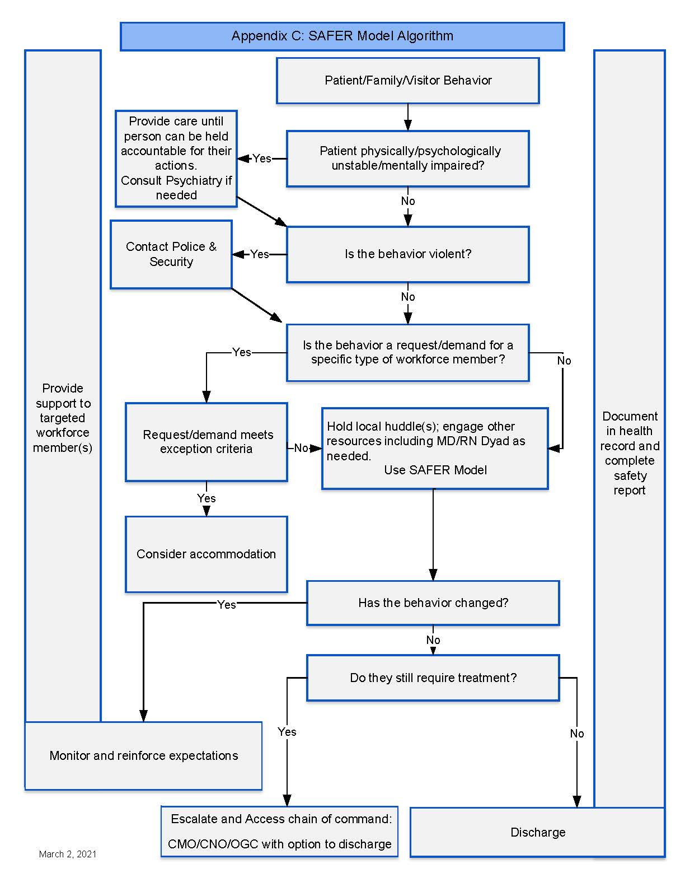
MGH Strategies to Address the Issues (cont.)
Diagram demonstrates SAFER model algorithm:
Clarity on reporting, documentation, and involvement of Police and Security
Expanded scripting in new guideline including provision of support
Includes handout/poster
Workflow diagram/algorithm

Slide 16
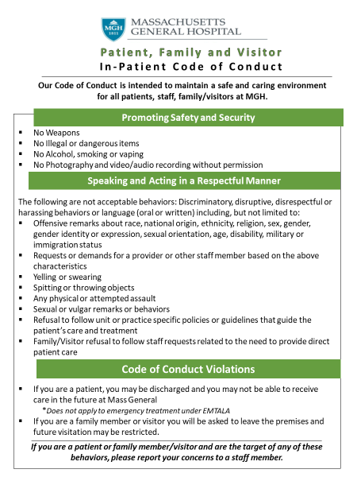
MGH Strategies to Address the Issues (cont.)

Slide 17
MGH Strategies to Address the Issues (cont.)
There are multiple policies and practices at MGH that, through structural racism, have a disproportionate/negative impact on minority patients and employees.
The 10-point plan creates a deliberate process to systematically identify such policies and practices and reconcile them.

Slide 18
Case Scenario
How should providers respond when patients exhibit biased or discriminatory behavior?
When a family requests a white nurse, “I’m sorry. Please do not touch my daughter. We would prefer a different nurse.”
What would you do?

Slide 19
Conclusion
Cultural change is necessary to meaningfully address patient bias against providers.
Healthcare organizations must acknowledge and address the prevalence and harm caused by biased patients
Create a culture that normalizes reporting incidents of discrimination

Slide 20
Conclusion
The emphasis on patient-centeredness has unintentionally emboldened a “patient first’ approach at the expense of emotional or physical distress to providers.
Healthcare organizations should carefully balance their duty to provide high-quality care and tend to the vulnerability of patients with their responsibility to cultivate a supportive, respectful work environment

Slide 21
References
Chandrashekar, P., & Jain, S. H. (2020). Addressing patient bias and discrimination against clinicians of diverse backgrounds. Academic Medicine, 95(12S), S33-S43.
Commodore-Mensah, Y., & Cooper, L. A. (2021). Reversing the Tide of Racial and Ethnic Disparities in Excess Deaths During the COVID-19 Pandemic. Annals of internal medicine
Garran, A. M., & Rasmussen, B. M. (2019). How should organizations respond to racism against health care workers?. AMA journal of ethics, 21(6), 499-504.
Olson, L. L., & Stokes, F. (2016). The ANA code of ethics for nurses with interpretive statements: Resource for nursing regulation. Journal of Nursing Regulation, 7(2), 9-20.
Paul-Emile, K., Smith, A. K., Lo, B., & Fernández, A. (2016). Dealing with racist patients. New England J. Med., 374, 708.
Prather, C., Fuller, T. R., Jeffries IV, W. L., Marshall, K. J., Howell, A. V., Belyue-Umole, A., & King, W. (2018). Racism, African American women, and their sexual and reproductive health: a review of historical and contemporary evidence and implications for health equity. Health equity, 2(1), 249-259.
Reynolds, K. L., Cowden, J. D., Brosco, J. P., & Lantos, J. D. (2015). When a family requests a white doctor. Pediatrics, 136(2), 381-386.
Sue, D. W., Alsaidi, S., Awad, M. N., Glaeser, E., Calle, C. Z., & Mendez, N. (2019). Disarming racial microaggressions: Microintervention strategies for targets, White allies, and bystanders. American Psychologist, 74(1), 128.
Williams, K. E., Baskin, M. L., Brito, A. L., Bae, S., & Willett, L. L. (2021). Supporting Trainees by Addressing Inappropriate Behaviors by Patients. Southern Medical Journal, 114(2), 111-115.
Winland-Brown, J. , Lachman, V. & Swanson, E. (2015). MEDSURG Nursing, 24 (4), 268-271.

