Slide 1
Addressing and Dismantling Structural Racism in Nursing Education
Sheldon D. Fields, PhD, RN, CRNP, FNP-BC, AACRN, FAANP, FNAP, FAAN
Associate Dean for Equity and Inclusion –Penn State University
First Vice President-National Black Nurses Association, Inc
December 4, 2021

Slide 2
Educational Learning objectives
By the end of this presentation participants will be able to:
Define Institutional, Systemic, and Structural Racism
Identify policies and practices aimed to dismantle racism within nursing education and clinical practice
Discuss the impact of micro-aggressions on students, faculty and nursing education
Discuss strategies to dismantle structural racism in nursing education

Slide 3
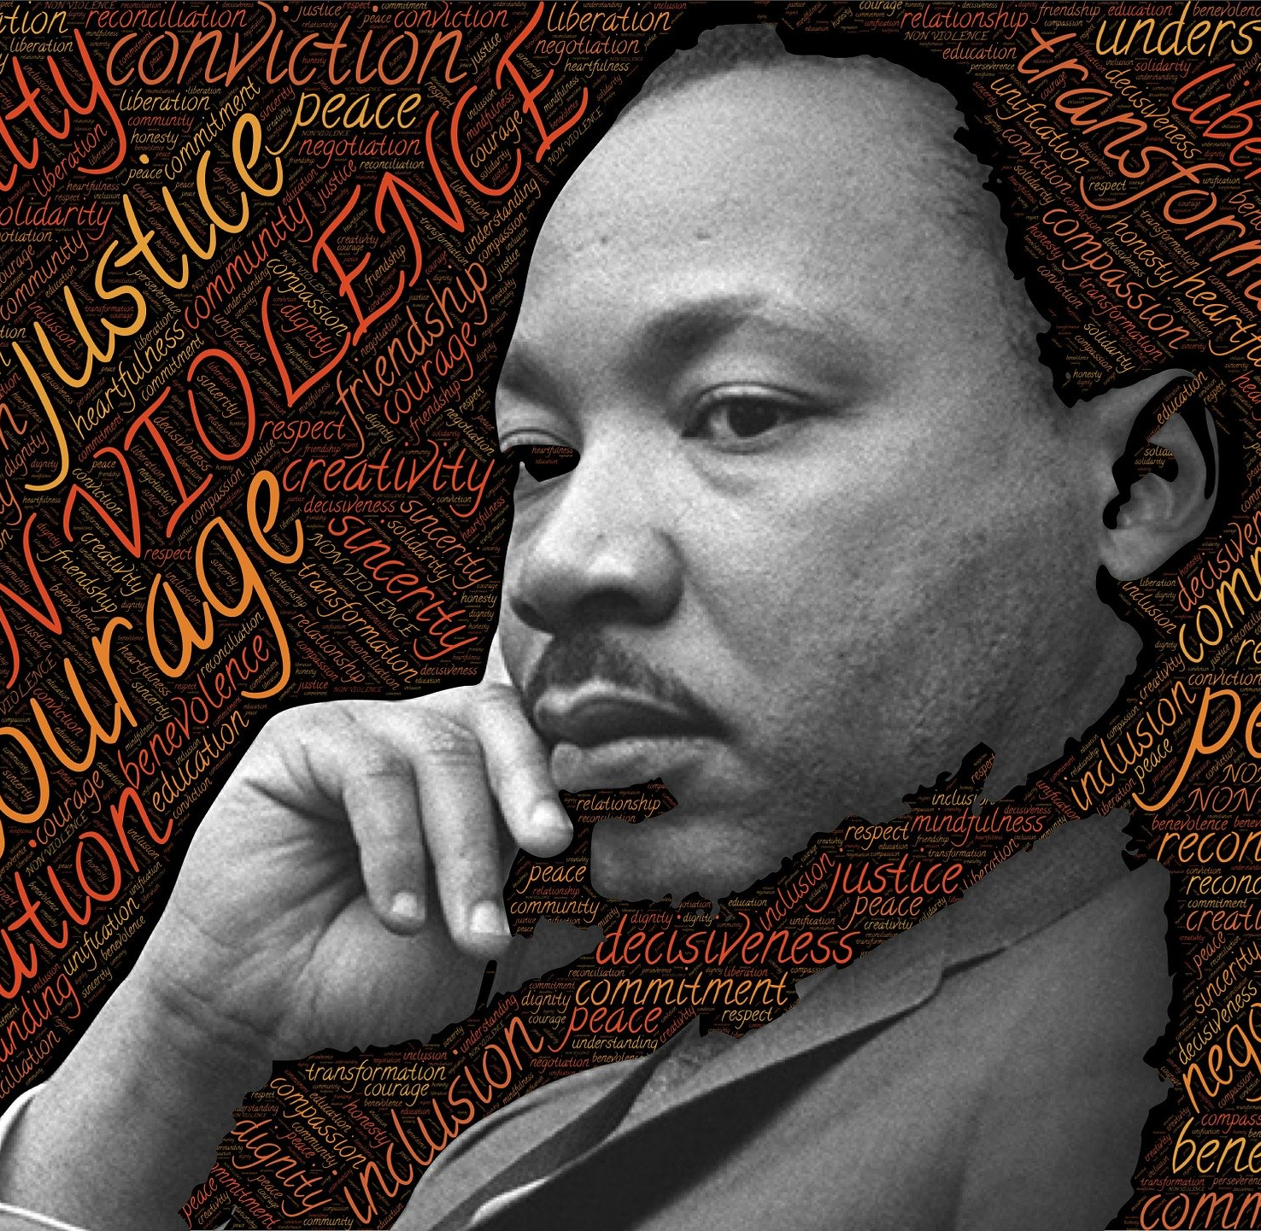
“Of all the forms of inequality, injustice in health care is the most shocking and inhumane.”
Rev. Dr. Martin Luther King Jr.

Slide 4
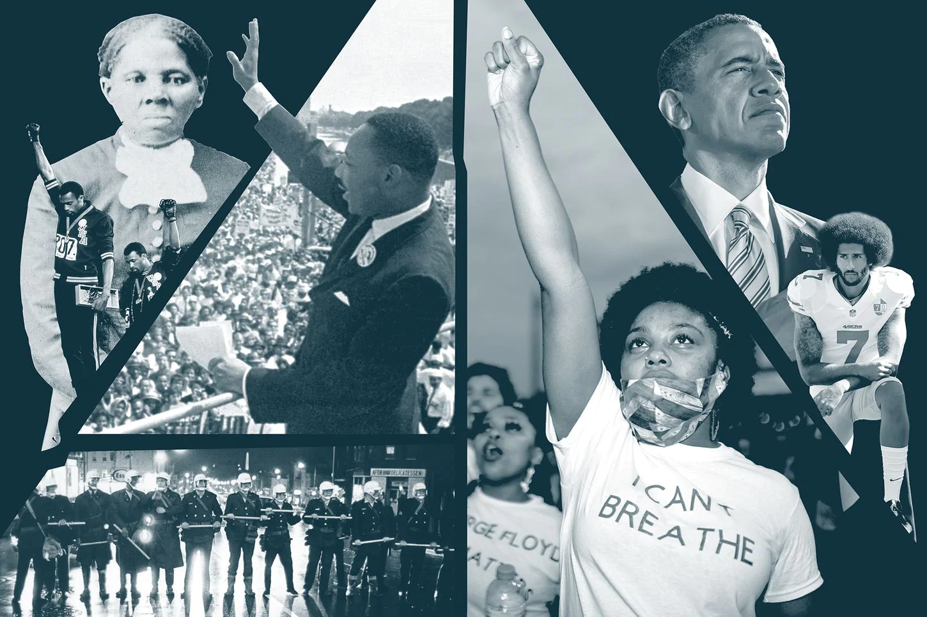
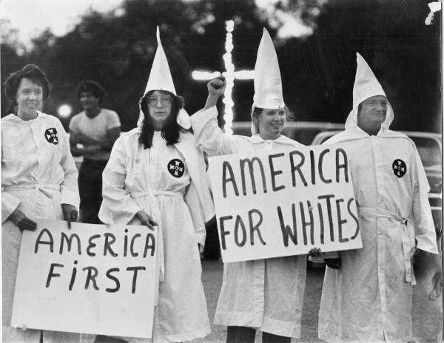
How did we get here

Slide 5
Racism not Race in America drives Inequality
BLACK LIVES MATTER

Slide 6
So, What does this have to do with the nursing profession and nursing education?

Slide 7
Nursing Education Programs in the U.S.
996 Nursing baccalaureate programs in the United States
282 accelerated baccalaureate programs and 64 accelerated or entry-level master’s programs
Over 1,000 ADN Nursing programs
Over 60 Diploma Nursing programs
More than 500 nursing schools offer a menu of more than 2,000 graduate programs
357 DNP programs
106 new DNP programs are in the planning stages
80 Nursing PhD Programs

Slide 8
Nursing Programs turn away Thousands of Students each year
According to AACN in 2020: 80,521 qualified applications were not accepted at schools of nursing
Shortage of clinical sites, faculty, and resource constraints
66,274 from entry-level baccalaureate programs
1,376 from RN-to-baccalaureate programs
8,987 from master’s programs
3,884 from doctoral programs

Slide 9
The Nursing Profession Is
The largest segment of the healthcare workforce
4 Million+ RN’s
The most trusted profession

Slide 10
Data From 2013-2017 Found That Nursing in the United States Does Not Reflect the Country’s Racial and Gender Diversity¹
90%
FEMALE
80%
WHITE
“The decade ahead will demand a stronger, more diversified nursing workforce that is prepared to provide care; promote health and well-being among nurses, individuals, and communities; and address the systemic inequities that have fueled wide and persistent health disparities” (NASEM, 2021)

Slide 11
U.S Racial Population vs. Nursing Racial Distribution
Racial Group | U.S Population^ 2010 / 2019 | Nursing Workforce Population*# 2010/2019
White | 72% / 60.1% | 83% / 80%
Black / African American | 13% / 13.4% | 6% / 6.2%
American Indian / Alaskan | 0.9% / 1.3% | >1% / 0.4%
Asian | 5% / 5.9% | 6% / 7.5%
Hispanic / Latino | 16% / 18.5% | 3% / 5.3%
Native Hawaiian / Pacific Islander | 0.2% / 0.2% | >1% / 0.5%
USDHHS (2019), ^U.S Census Bureau (2020), #NCSBN (2013; 2018/19)

Slide 12
What do we mean when we say?
Diversity
Understanding that each individual is unique, and recognizing their individual differences, including but not limited to race, ethnicity, gender, gender identity, sexual orientation, age, social class, physical ability or attributes, religious or ethical values system, national origin, and political beliefs
Equity
Is about giving people what they need, in order to make things fair. Typically giving more to those who need it
Inclusion
A feeling of security and support when there is a sense of acceptance, belonging, and identity for a person within certain spaces and groups

Slide 13
Racism Defined and its forms

Slide 14
Finding Common Meaning
Racism
A belief that race is a fundamental determinant of human traits and capacities and that racial differences produce an inherent superiority of a particular race
Antiracism
Anti-racism refers to a form of action against racial hatred, bias, systemic racism, and the oppression of marginalized groups. Anti-racism is usually structured around conscious efforts and deliberate actions to provide equitable opportunities for all people on an individual and systemic level
Antiracist
A person who opposes racism and promotes racial tolerance

Slide 15
Dr. Ibram X. Kendi: How to be an Antiracist
Believes that there is no in between safe space of being “Not Racist”, one is either “RACIST” or “ANTIRACIST”
The claim of not racist neutrality is a mask for racism
What’s the Difference?
A racist endorses the idea of a racial hierarchy
An antiracist endorses the idea of racial equality

Slide 16
Forms of Racism
Structural / Systemic Racism: A system in which public policies, institutional practices, cultural representations, and other norms work in various, often reinforcing ways to perpetuate racial group inequity
It identifies dimensions of our history and culture that have allowed privileges associated with “whiteness” and disadvantages associated with “color” to endure and adapt over time
It is a feature of the social, economic and political systems in which we all exist
Institutional Racism: Refers to the policies and practices within and across institutions that, intentionally or not, produce outcomes that chronically favor, or put a racial group at a disadvantage
Criminal Justice, School systems, Employment

Slide 17
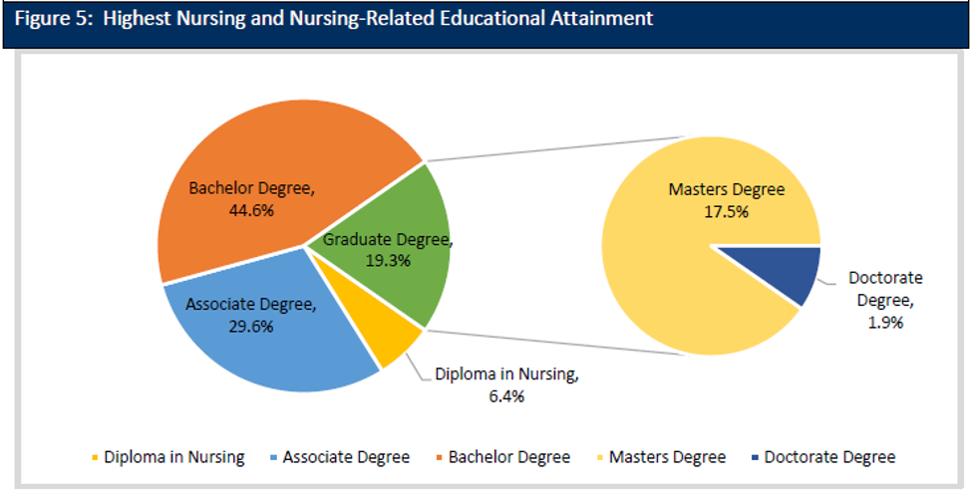
Exemplar: Doctoral Education

Slide 18
The Need for Diverse Nurses with Doctorates
The overall number of nursing doctorate programs has increased
The total enrollment of students in PhD nursing programs has remained fairly constant
Resulting in a shortage of newly minted PhDs to renew faculty ranks
Approximately 50% of nursing faculty possess the doctorate as a terminal degree
The Number of DNP doctoral nursing programs has exploded
More students of color in DNP vs. PhD programs
Becoming an APN (NP, CRNA, CNM, CNS) will soon require a DNP
DNP make more in practice and most in academia are in non-tenure earning positions

Slide 20
Nursing PhD vs. DNP Graduates

Slide 21
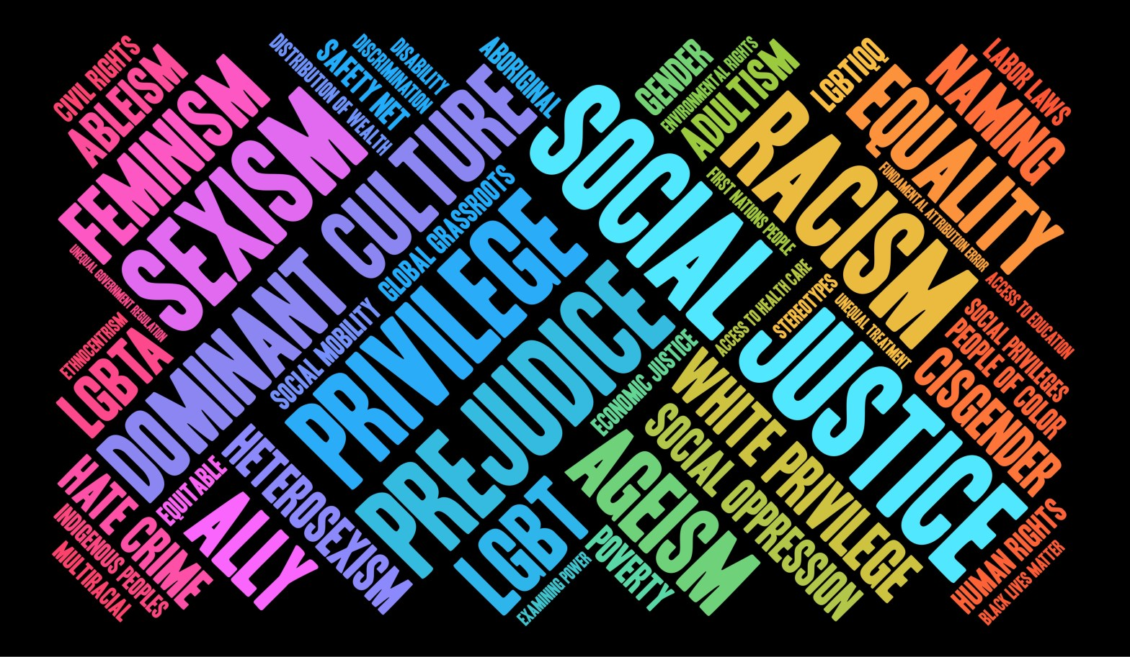
Why is Dismantling Racism in Nursing Education so Important?
Racism is a major driver of health care disparities
We will never achieve health equity

Slide 22
IOM: Unequal Treatment: Confronting Racial and Ethnic Disparities in Health Care
Minorities receive a lower quality of care than whites
Even when they have the same health insurance or the ability to pay
Causes of Healthcare Disparities
Healthcare system organization and operation
Cost containment, Public health insurance, Access
Patients’ attitudes and behaviors
Historical mistrust, not following doctor’s orders
Healthcare providers biases, prejudices, and uncertainty when treating minorities
Ism’s and Stereotypes, communication
[IOM (2003). Unequal Treatment: Confronting Racial and Ethnic Disparities in Health Care.]

Slide 23
When White folks catch a cold, Black folks get pneumonia

Slide 24
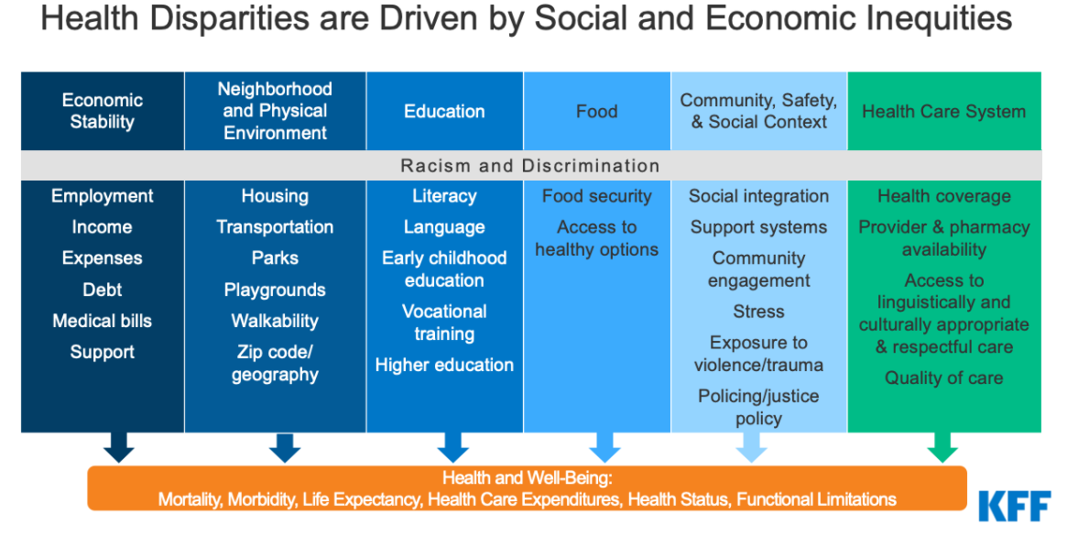
Notes:
Circumstances in which people are:
Born, grow up, live, work and age, and the systems put in place to deal with illness
These circumstances are in turn shaped by a wider set of forces:
Economics, Social policies, and Politics
Social determinants are often a strong predictor of health disparities:
Race and ethnicity, gender, sexual identity, age, disability, socioeconomic status, and geographic location

Slide 25
Health Equity Dr. Camara Jones (2014)
Health Equity: Assurance of the conditions for optimal health for all people
Three principles to achieve health equity:
Providing resources according to need
Valuing all individuals and populations equally
Recognizing and rectifying historical injustices

Slide 26
Moving Toward Health Equity
Definitions of Health Equity
“Health equity is the state in which everyone has the opportunity to attain full health potential and no one is disadvantaged from achieving this potential because of social position or any other socially defined circumstance” (NASEM, 2017)
“Health equity is defined as the absence of unfair and avoidable or remediable differences in health among population groups defined socially, economically, demographically or geographically” (WHO, 2020)

Slide 27
ANA Nursing Code of Ethics
Provision 5: “The nurse owes the same duties to self as to others, including the responsibility to promote health and safety, preserve wholeness of character and integrity, maintain competence, and continue personal and professional growth.”
Provision 6: “The nurse, through continual and collective effort, establishes, maintains, and improves the ethical environment of the work setting and conditions of employment that are conducive to safe, quality health care.”
Provision 7: “The nurse, in all roles and settings, advances the profession through research and scholarly inquiry, professional standards development, and the generation of both nursing and health policy.”
Provision 8: “The nurse collaborates with other health professionals and the public to protect human rights, promote health diplomacy, and reduce health disparities.”
Provision 9: “The profession of nursing, collectively through its professional organizations, must articulate nursing values, maintain the integrity of the profession, and integrate principles of social justice into nursing and health policy.”
Provision 1: “Nurses must practice with compassion and respect for the inherent dignity, worth, and unique attributes of every person.”
Provision 2: “The nurse’s primary commitment is to the patient, whether an individual, family, group, community, or population.”
Provision 3: “The nurse promotes, advocates for, and protects the rights, health, and safety of the patient.”
Provision 4: “The nurse has the authority, accountability, and responsibility for nursing practice; makes decisions; and takes action consistent with the obligation to promote health and to provide optimal care.”

Slide 28
The Future of Nursing 2020-2030: Charting a Path to Achieve Health Equity
Vision
The achievement of health equity in the United States built on strengthened nursing capacity and expertise
Health Equity achieved through ten desired Nursing Outcomes
Nurses are prepared to act individually, through teams, and across sectors to meet challenges associated with an aging population, access to primary care, mental and behavioral health problems, structural racism, high maternal mortality and morbidity, and elimination of the disproportionate disease burden carried by specific segments of the U.S. population
Nurses reflect the people and communities served throughout the nation, helping to ensure that individuals receive culturally competent, equitable health care services
Health care systems enable and support nurses to tailor care to meet the specific medical and social needs of diverse patients to optimize their health

Slide 29
The Future of Nursing 2020-2030: Charting a Path to Achieve Health Equity
Nursing Roles and Leadership
Conclusion 9-4: Nurse leaders have a responsibility to address structural racism, cultural racism, and discrimination based on identity (e.g., sexual orientation, gender), place (e.g., rural, urban), and circumstances (e.g., disabled, mental health condition) within the nursing profession and to help build structures and systems at the societal level that address these issues to promote health equity
Recommendation 9:
The National Institutes of Health, the Centers for Medicare & Medicaid Services, the Centers for Disease Control and Prevention, the Health Resources and Services Administration, the Agency for Healthcare Research and Quality, the Administration for Children and Families, the Administration for Community Living, and private associations and foundations should convene representatives from nursing, public health, and health care to develop and support a research agenda and evidence base describing the impact of nursing interventions, including multisector collaboration, on social determinants of health, environmental health, health equity, and nurses’ health and well-being

Slide 30
What can nursing do to Dismantle Racism

Slide 31
Top TEN Ways to be Antiracist in Nursing

Slide 32
To be Antiracist in Nursing

Slide 33
To be Antiracist in Nursing

Slide 34
To be Antiracist in Nursing

Slide 35
To be Antiracist in Nursing

Slide 36
To be Antiracist in Nursing

Slide 37
Teaching a more Inclusive Nursing History
Nursing History if taught at all in nursing schools is usually taught from a White Eurocentric female perspective

Slide 38
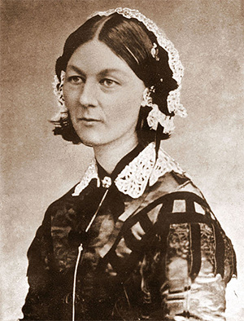
Promote an Inclusive Nursing History
Mary Seacole: (1805, Kingston, Jamaica— May 14, 1881, London, England), Jamaican businesswoman who provided sustenance and care for British soldiers at the battlefront during the Crimean War
Florence Nightingale: (1820 – 1910), Credited as being the Founder of Modern Nursing. Also provide care to soldiers during the Crimean War.

Slide 39
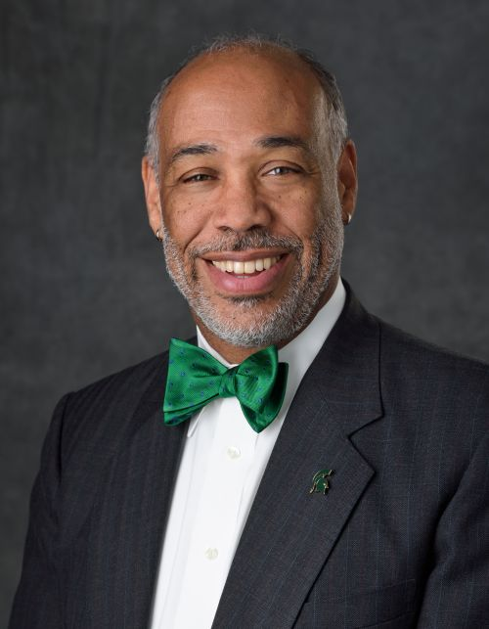
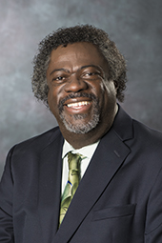
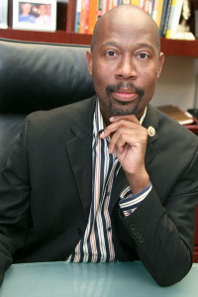
Modern Inclusive Nursing History Exemplar
Courtney Lyder, ND, RN, FAAN
Frist Black Male named dean of a U.S. nursing school (UCLA, 2008)
Eric J. Williams, DNP, RN, CNE, FAAN - First Male president of National Black Nurses Association
Randolph F. R. Rasch, PhD, RN, FNP, FAANP, FAAN – Frist Black Male to ever earn a PhD in Nursing
Ernest Grant, PhD, RN, FAAN- 36th president of the ANA
First male ANA President

Slide 40
A website and archive celebrating the contributions of BIPOC nurses to the nursing profession.
Started by nurses and launched on February 1, 2021 to coincide with Black History Month
Website: https://medium.com/nurses-you-should-know
My Profile: https://medium.com/nurses-you-should-know/sheldon-d-fields-5d0d219e31e6

Slide 41
Conclusions
There is currently more attention being given to the importance of diversity, equity and belonging
The lack of diversity, equity and inclusion in Nursing is a driver of health disparities
SDOH, NDOH, and racism remain major drivers of health disparities
Nursing has a moral, and ethical responsibility to address DEI issues and dismantle racism
Best Practices for dismantling racism in nursing
Teach a more inclusive and racially truthful version of nursing history
Dedicated to diversifying the nursing profession, especially at the doctoral level
Willing to implement antiracist initiatives such as changing admission and progression policies
Commission on racism in nursing Top TEN ways

Slide 42
Internet Resources
Beyond Florence – Web site
https://nursingclio.org/2021/02/04/moving-beyond-florence-why-we-need-to-decolonize-nursing-history/
Healthy People 2030
https://health.gov/healthypeople
National Academy of Medicine / Culture of Health Tools
https://nam.edu/programs/culture-of-health/culture-of-health-tools-and-resources/
National Institute on Minority Health and Health Disparities
https://www.nimhd.nih.gov/
IOM The future of Nursing 2020 – 2030
https://nam.edu/publications/the-future-of-nursing-2020-2030/
IOM Unequal Treatment: Confronting Racial and Ethnic Disparities in Health Care
http://www.nationalacademies.org/hmd/Reports/2002/Unequal-Treatment-Confronting-Racial-and-Ethnic-Disparities-in-Health-Care.aspx

Slide 43
Institutional Racism via Michael Jackson
When you have a moment here is a video that you can take a look at and share with your colleagues, family, & friends
It is a very simple but powerful explanation of institutional racism
Recommendation: Use as an introduction for any trainings on institutional racism
Great ice breaker and conversation starter
Link: https://www.trtworld.com/video/social-videos/institutional-racism-in-us-explained-through-a-michael-jackson-song/5ace29d41b01722a81cbf1e7

Slide 44
Contact Information
Sheldon D. Fields
PhD, RN, FNP-BC, AACRN, FAANP, FNAP, FAAN
Email: sdf5275@psu.edu
Phone: 814-863-8215
LinkedIn: https://www.linkedin.com/in/sheldon-d-fields-phd-rn-crnp-fnp-bc-aacrn-fnap-faanp-faan-a5255476/
Wikipedia: https://en.wikipedia.org/wiki/Sheldon_D._Fields

